Slide 1

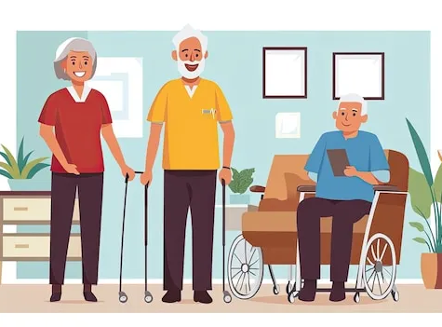
Elderly Care Management System(ECMS) – Yr 4 Project
By Qadeer Hussain
Supervisor: Paul Barry
Date: 25/10/2024

Slide 2
The ECMS Project
Create a secure web application, to secure patient data.
The creation of this application will help alleviate and modernize patient data management by replacing manual documentation with digital system.
To comply with Health Level 7 standard.

Slide 3
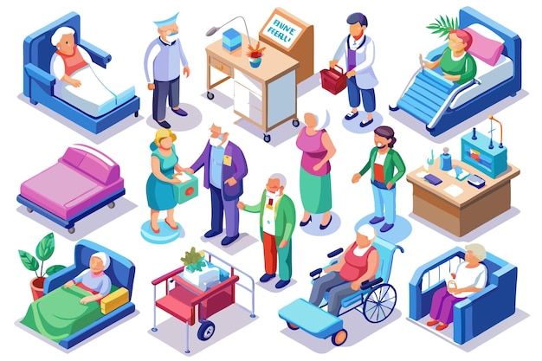
Who is it for
Care Homes
Care Office Staff (Admin)
Carer’s

Slide 4


Features
Login
Register
Patient Profile
Care Plan
Medical Dashboard
Roster
Incident Reporting
Alert
Health Level 7
Security (Cryptography)
Shared Key encryption
Public Key encryption

Slide 5



Technologies

Slide 6



Existing Systems
Pass App created by Every Life
Founded in 2014
Real time care monitoring app
Mainstream functionality
Log my Care
Makes person centred technology accessible to everybody in social care
Mainstream functionality
Nourish
Mainstream functionality
Personalised Care plans
Control and security on all Patient data

Slide 7
Potential Issues/Challenges
This will be a learning curve for me as I will get an opportunity to gain more knowledge about cryptography.
Adhering to the Health Level 7 Standards.
Ease of access and navigation.
Project management and time management to adhere to deadlines.
Complete Core functionality.

Slide 8
References
Pass by Everylife, 2024. Pass. [Online] Available at: https://www.everylifetechnologies.com/ [Accessed October 2024].
Nourish, 2024. Nourish. [Online] Available at: https://nourishcare.com/ [Accessed October 2024].
Log my Care, 2024. Log my Care. [Online] Available at: https://www.logmycare.co.uk/ [Accessed October 2024].
Health Level Seven International, 2024. Introduction to HL7 Standards. [Online] Available at: https://www.hl7.org/implement/standards/index.cfm?ref=nav [Accessed October 2024].
(2024a) Freepik | create great designs, faster.
Available at: https://www.freepik.com/
(Accessed: October 2024).
https://www.python.org/
https://www.djangoproject.com/
https://mariadb.org/
https://pypi.org/project/cryptography/

Slide 9

Thank you any Questions?

